Slide 1
ElevateLabs-Task4- Sales Dashboard Overview
Venkatesh Babu Chunduri | Data Analyst Intern | 2025

Slide 2
Objective and overview of Dashboard
Objective:
To provide actionable insights into sales performance, profitability, and customer segmentation, enabling data-driven decisions for enhanced business strategies.
Overview:
The dashboard highlights key metrics such as sales trends (2011–2015), profitability by category, top-selling products, regional and state-wise performance, and the impact of shipping modes on profit. It serves as a comprehensive tool for analyzing and optimizing sales dynamics.

Slide 3
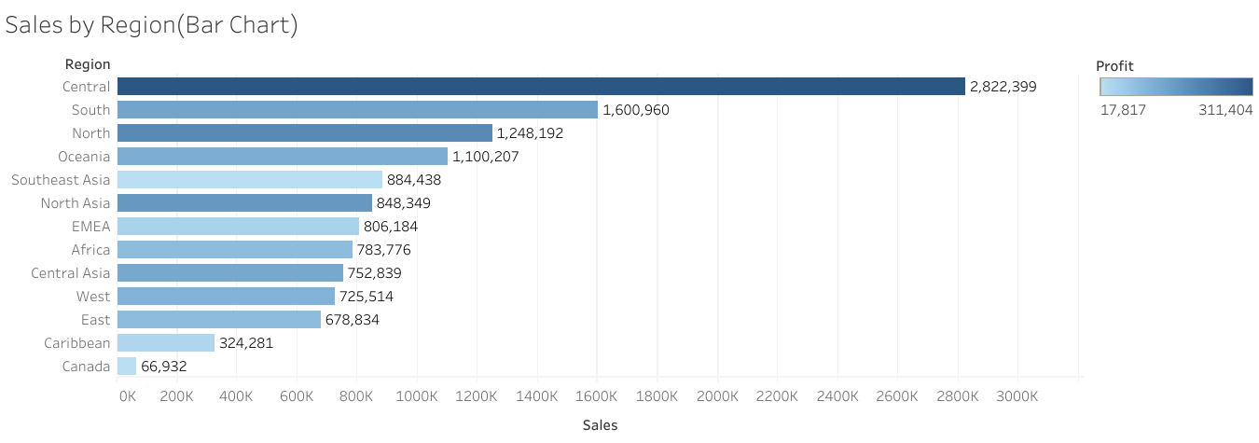
Sales by Region Analysis
Description: "This bar chart highlights sales performance across regions, with Central leading the charts at ₹2,822,399. It also reflects a correlation between high sales and profitability."
Insights:
Central region dominates sales, contributing the most revenue.
Low-performing regions like Canada present opportunities for strategic improvement.

Slide 4
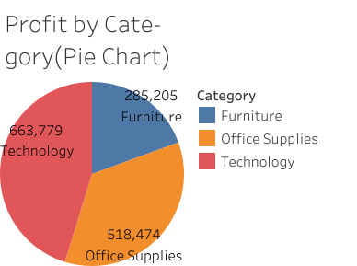
Profit by Category Analysis
Description: "This pie chart illustrates the distribution of profit across categories: Furniture, Office Supplies, and Technology. The largest contributor is Technology, with a profit of ₹663,779, followed by Office Supplies at ₹518,474."
Insights:
Technology accounts for the highest profit, making it the key focus area for growth.
Furniture shows the lowest profit, indicating potential for strategic improvements.

Slide 5
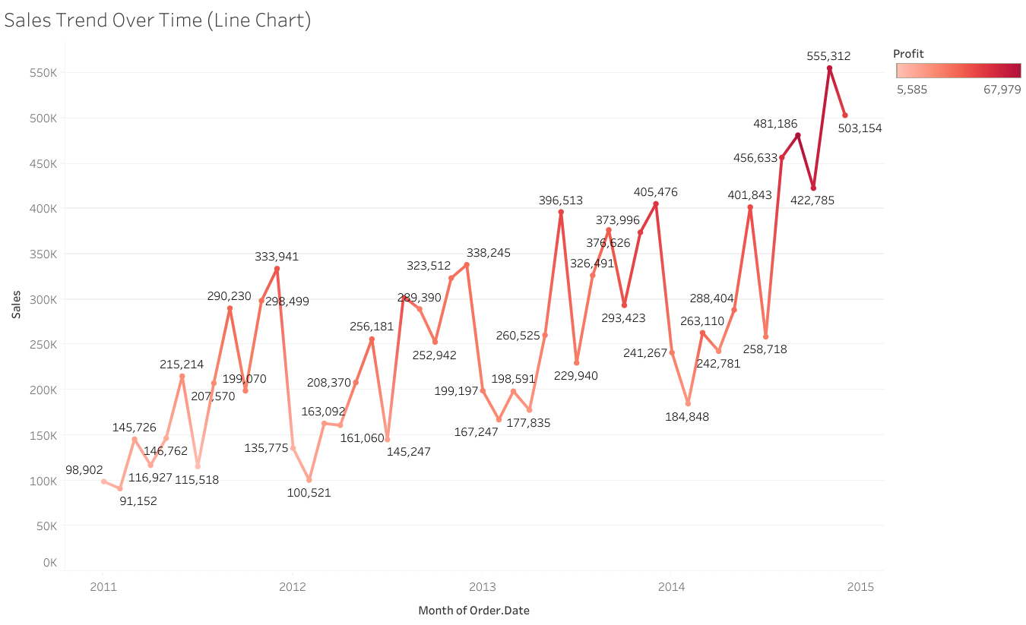
Sales Trend Over Time
Description:
This chart showcases monthly sales from 2011 to 2015, highlighting growth and seasonal variations.
Insights:
Sales peaked at 555,312 dollars in 2015, with notable fluctuations influenced by seasonal factors. Lower profit periods were observed in 2011.
This condensed format is perfect for your presentation! Let me know if you need adjustments.

Slide 6
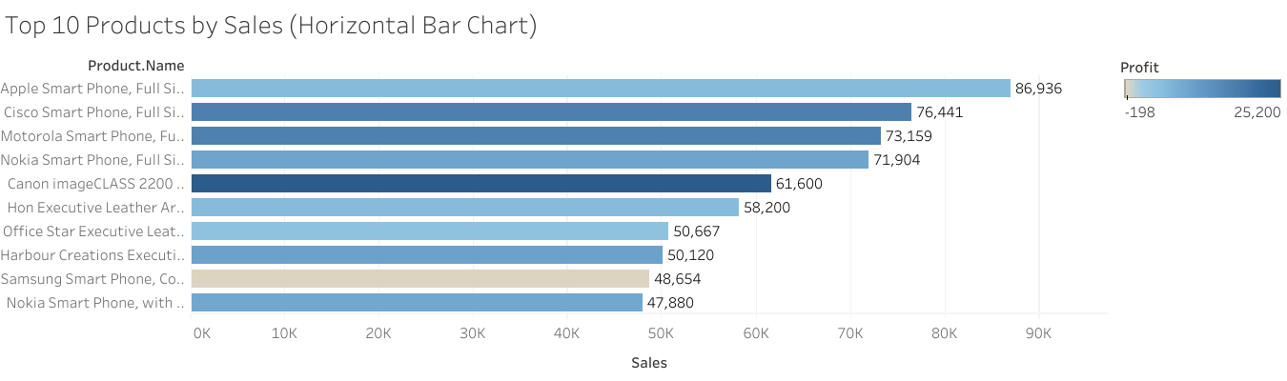
Top 10 Products by Sales
Description:
This chart highlights the top-selling products with their respective sales figures and profitability, providing insights into product performance.
Insights:
The Apple Smart Phone leads in sales at 86,936 dollars, followed by Cisco and Motorola Smart Phones. Profitability varies, with some products showing lower profit margins despite high sales.

Slide 7
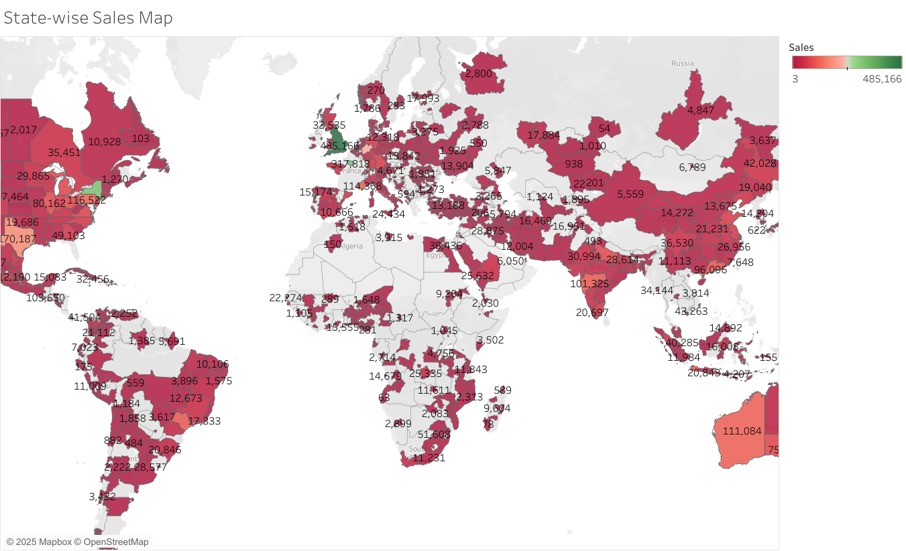
State-Wise Sales Analysis
Description:
This map visualizes sales distribution across various states, using a color gradient from green to red to represent sales figures ranging from 3 to 485,166 dollars.
Insights:
Central regions exhibit the highest sales performance, while certain states show lower figures, offering opportunities for targeted strategies and improvements.

Slide 8
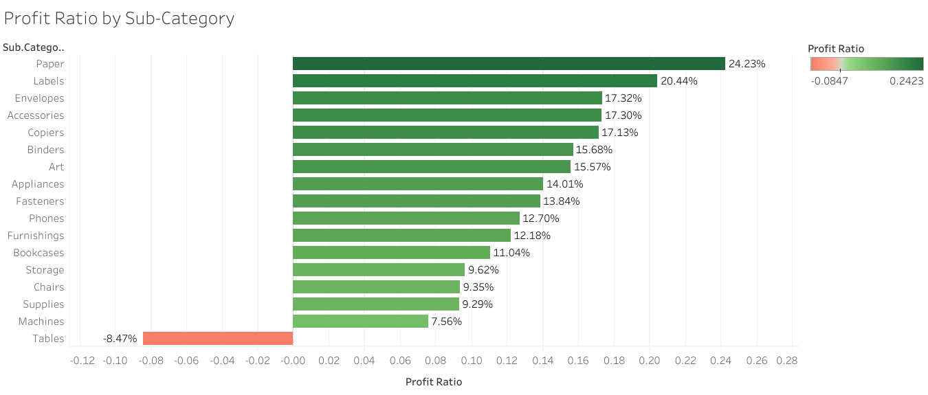
Profit Ratio by Sub-Category
Description:
This chart represents the profit ratios of various product sub-categories, with a gradient color scheme indicating positive (green) and negative (red) profitability.
Insights:
Sub-categories like Paper and Labels show the highest profit ratios (24.23% and 20.44%), while Tables have the lowest profit ratio at -8.47%, highlighting areas of strong performance and potential improvement.

Slide 9
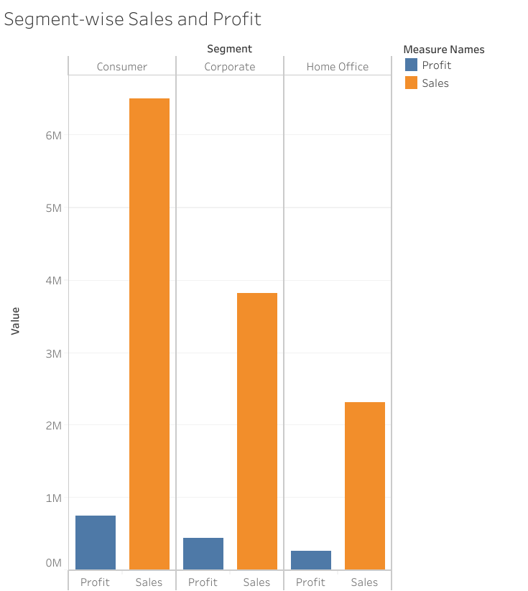
Segment-Wise Sales and Profit Analysis
Description:
This bar chart showcases sales and profit data for three segments—Consumer, Corporate, and Home Office—using a clear visual comparison.
Insights:
The Consumer segment leads in both sales and profit, followed by Corporate, while Home Office exhibits the lowest performance, offering scope for improvement strategies.

Slide 10
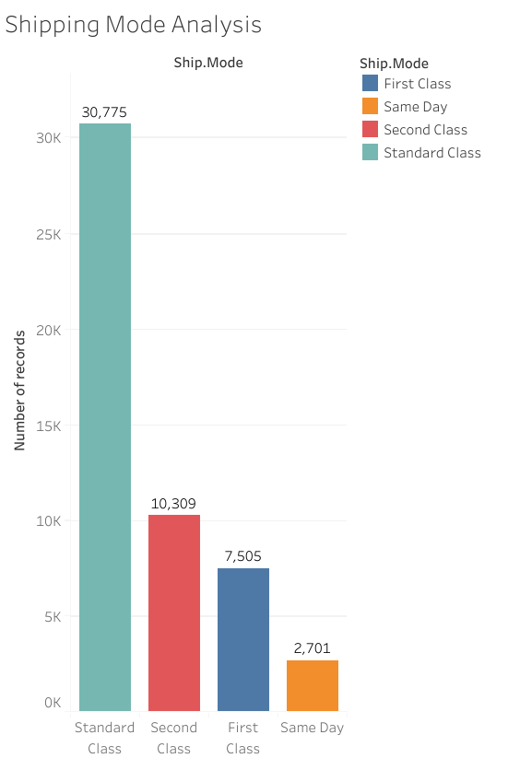
Shipping Mode Analysis
Description:
This chart displays the number of transactions for four shipping modes: Standard Class, Second Class, First Class, and Same Day.
Insights:
Standard Class accounts for the majority of transactions (30,775), followed by Second Class (10,309), while Same Day has the least (2,701), indicating a preference for cost-effective shipping options.

Slide 11
Key Metrics Used in the Dashboard
Description:
This dashboard consolidates critical sales and profitability metrics, providing stakeholders with an interactive tool for monitoring performance and making data-driven decisions. It covers aspects like sales trends, profitability by category, customer segmentation, and regional performance for a comprehensive understanding of the business.
Insights:
Sales Growth: Sales increased significantly from 2011 to 2015, despite periodic fluctuations.
Profitability Analysis: Sub-categories like Paper and Labels show the highest profit ratios, driving overall profitability.
Top Products: Apple Smart Phone leads as the highest-selling product, offering insights into customer preferences.
Geographical Insights: The Central region dominates sales, with state-wise mapping highlighting high-performance areas.
Customer Segmentation: Consumer and Corporate segments show distinct sales patterns, aiding targeted strategies.
Shipping Modes: First Class shipping stands out for its profitability, informing logistics optimization.

Slide 12
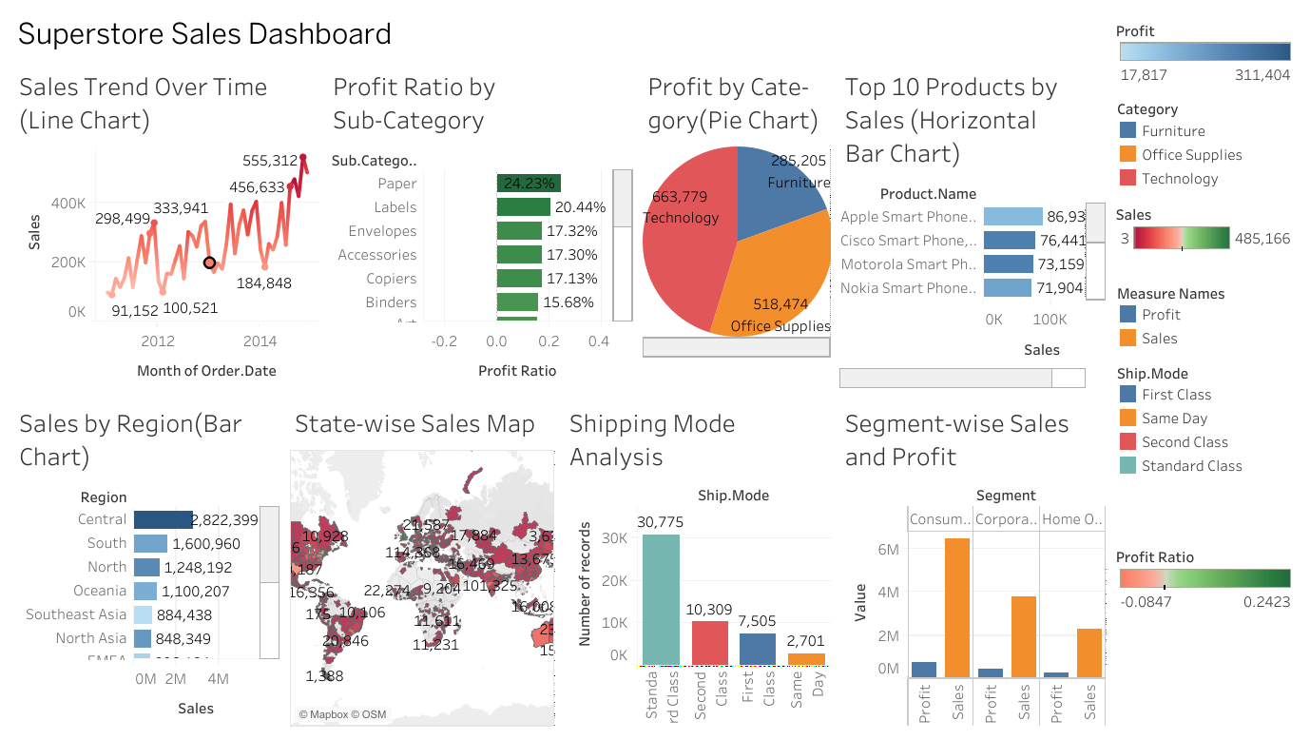

Slide 13
Key Insights from the Dashboard
Sales peaked at 555,312 dollars in 2015, showcasing substantial growth over time.
Profitability is strongest in sub-categories like Paper and Labels, while Tables show significant losses (-8.47%).
Apple Smart Phone ranks highest in sales among all products, highlighting customer preferences.
The Consumer segment leads in both sales and profit, while Home Office lags behind.
The Central region dominates state-wise performance, offering actionable geographic insights.
First Class shipping is the most profitable mode, while Standard Class is preferred for the majority of transactions.

